Slide 1
SSA Parent Information
Notes:
Welcome to the Single Subject Acceleration parent presentation.

Slide 2
What is Single Subject Acceleration (SSA)?
Single Subject Acceleration (SSA) is the practice of placing a student in a higher-grade level in one subject area. This type of acceleration is for the purpose of providing access to appropriately challenging learning opportunities in either math or English Language Arts.
Notes:
Single Subject Acceleration (SSA) is the practice of assigning a student to a higher-grade level than is typical, given the student’s age, for the purpose of providing access to appropriately challenging learning opportunities in either Math or English Language Arts.
Who is eligible to be nominated?
Any student who is enrolled in Wake County Public School system during the SSA Test Request Window is eligible for testing.

Slide 3
Who can be tested for SSA?
Current Kindergarten students through 7th grade students
Requests for SSA testing comes from parents
Notes:
Who is eligible to be tested for SSA? Any Wake County Public School System student currently in Kindergarten through 7th grade can have their parent request testing for single subject acceleration in one subject area only. The only reason a 7th grade student might take the SSA test in math would be if the student was in 7th grade and did not take 7 plus, but the student wants to take Math 1.
No student can skip Math 1.
Teachers may also request single subject testing for a student but a parent must give permission for the student to be tested. The SSA testing window is the only time during the school year that a child can be tested for SSA. Single Subject Acceleration classes will typically start the following school year. More information specifically on middle school placement for SSA will be discussed in more detail as we go through the presentation.

Slide 4
SSA Process from Test Request to Results
te
Test Request
Testing
Results
Schools share results with parents.
Parent communicate to the necessary school members they want to have their student(s) tested for SSA.
Students test on a computer while in the school building during the Testing Window. All testing must take place in the building.
Schools wait for final results from Advance Learning Services.
Schools share results with parents. Results will be used to plan instruction for the following school year.
SSA test requests can only be submitted during the test request windows for that school Schools prepare for testing.
Notes:
This graphic shows the SSA process. First parents need to complete a test request form and return it to their schools before the Test Request deadline. During the schools testing window, the SSA tests will be administered to students. Results will be shared with parents once scores have been returned. SSA services will begin the following school year.

Slide 5
Request and Testing Windows
SSA Parent Test Request Windows
Leadership Academies and Modified Calendar: Feb. 21-25 | Year Round Track 1: Feb. 21-25
Barwell ES, Fox & Walnut Creek ES: March 14-18 | Traditional Calendar and Year Round Tracks 2, 3, and 4: March 21-25
Test Requests will NOT be accepted after the window has closed.
Testing Windows
Leadership Academies: March 28-April 11 | Modified Calendar, Year Round Tracks 1, 2, and 3: April 4-19
Barwell ES, Fox & Walnut Creek ES: May 9-23 | Traditional Calendar, Year Round Track 4 April 18-May 3
Notes:
It is important to make sure that all test requests are given to the school’s SSA contact before the test request window closes. Test requests will not be accepted after the window has closed as materials have to be ordered early to assure that all deadlines are met. If you are unsure of your school calendar, reach out to your schools SSA contact for more information.

Slide 6
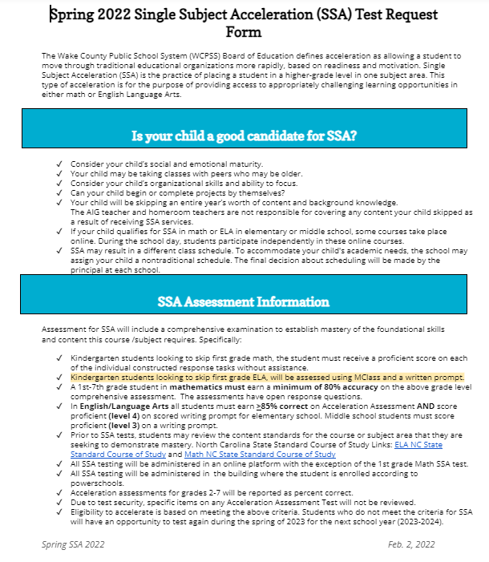
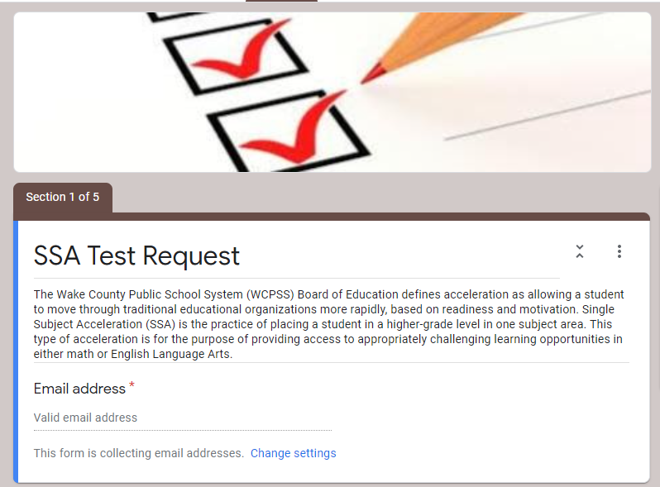
Test Request Form
Notes:
(teachers will need to link their school specific google form, if they choose to use this option)
The test request form is available from your schools. Please be sure to read the two sections titled: “Is your child a good candidate for SSA?” And “SSA Assessment Information” before returning the signed paperwork into your school's SSA contact.

Slide 7
SSA Testing (for Middle School)
A student must test and show mastery of the content area that they desire to skip.
A 6th grade student takes a 7th grade ELA assessment
If a 6th grade student passes the ELA assessment, the student will attend an 8th grade ELA class for ELA
Notes:
A 6th grade student will be taking a 7th grade ELA assessment to skip 7th grade ELA and take the 8th grade ELA next fall. Note that the student would need to pass both the ELA assessment and the writing assessment to be eligible to take 8th grade ELA while attending 7th grade math, social studies and science.

Slide 8
SSA Testing (Elementary School)
A student must test and show mastery of the content area that they desire to skip.
For example:
a 3rd grade student takes a 4th grade math or ELA assessment for SSA
If mastery is shown on the SSA assessment for 4th grade math or ELA, the third grader will take the fifth grade math/ELA course during their fourth grade year
Notes:
When a student takes the Single Subject Acceleration testing, the student must show mastery on the course that the student will be skipping.
For example:
a 3rd grade student will be taking a 4th grade assessment to skip 4th grade math.
If mastery is shown on the SSA assessment for the 4th grade math, the student will be placed in the fifth grade math class next year while taking ELA, science and social studies in the fourth grade.

Slide 9
SSA ELA Assessments
Student Current Grade Level | Grade/ Course Requesting to Skip | Assessment used to Qualify | Assessment Format | Qualifying Criteria
Kindergarten | 1st Grade ELA | MClass | An in-person written response assessment | MClass Maze score of 14.5 and proficient (level 4) on written response.
1st Grade | 2nd Grade ELA | Grade 2 Assessment | All assessments are for these grades have multiple choice and a written response. | .
2nd Grade | 3rd Grade ELA | Grade 3 Assessment
3rd Grade | 4th Grade ELA | Grade 4 Assessment
4th Grade | 5th Grade ELA | Grade 5 Assessment
5th Grade | 6th Grade ELA | Grade 6 Assessment
6th Grade | 7th Grade ELA | Grade 7 Assessment
7th Grade | 8th Grade ELA | Grade 8 Assessment
In English/Language Arts all students must earn >85% correct on Acceleration Assessment AND score proficient (level 4) on scored writing prompt for elementary school. Middle school students must score proficient (level 3) on a writing prompt.
Notes:
This slide outlines the assessment format and qualifying criteria for students looking to skip ELA content.
In grades 1-7 students will take a two part test: a multiple choice section and a written response. Students need to demonstrate that they have mastered the writing and reading standards for the course to be skipped.In English Language Arts all students must earn 85% correct on the multiple choice Acceleration Assessment. There is also a writing prompt administered after the multiple choice reading test in which students must score proficient. Remember, student must show mastery on both the multiple choice section AND the writing prompt in order to pass the ELA SSA assessment.

Slide 10
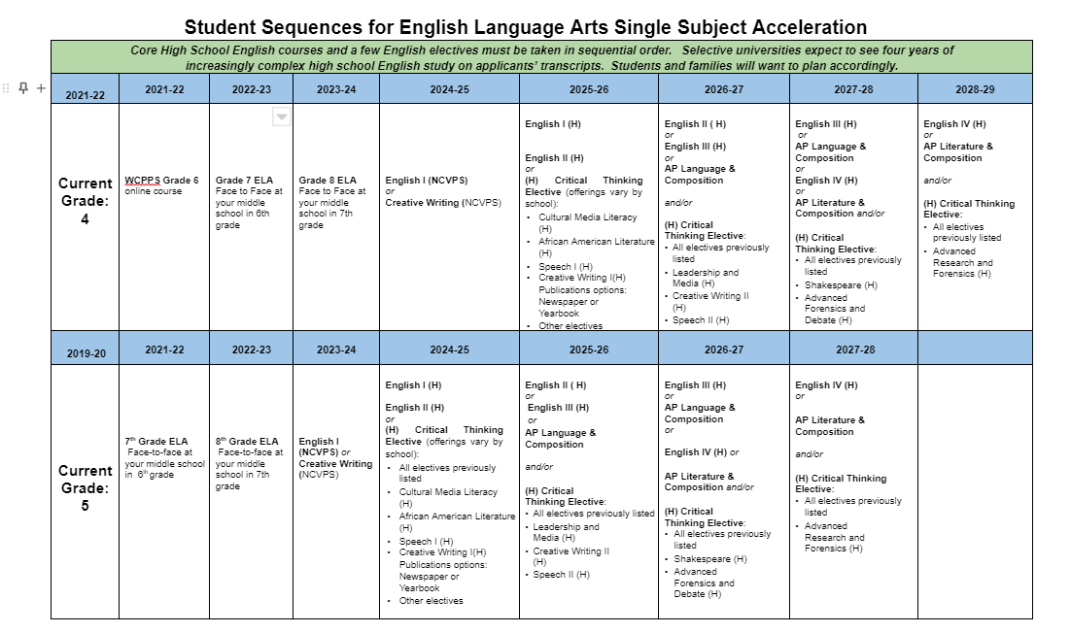
Looking Down the Road...ELA
21-22
22-23
23-24
24-25
25-26
26-27
27-28
28-29
29-30
21-22
22-23
23-24
24-25
25-26
26-27
27-28
28-29
Notes:
Click to second red circle: Students who are currently in grade 5 and qualify to skip 6th grade ELA will be enrolled in the Grade 7 ELA course during their 6th grade year. Grade 7 and 8 ELA courses are face to face in their middle school during their 6th and 7th grade school year. During 8th grade, students will enroll in EITHER English I (NCVPS) or Creative Writing (NCVPS) for a year-long course. Students must choose one of these two courses only.
After qualifying for SSA in ELA, the student’s trajectory of ELA courses will change.
For students in grades K-3 the school will place them in the face to face or virtual academy at the school level.
The pattern changes when fourth grade students skip fifth grade.
Let’s look at our chart
first red circle: Students who are in 4th grade, and qualify to skip 5th grade ELA will be enrolled in an online 6th grade course during their 5th grade year. These students will then take the Grade 7 and 8 ELA courses face to face in their middle school during their 6th and 7th grade. During 8th grade, students will enroll in EITHER English I (NCVPS) or Creative Writing (NCVPS) for a year-long course. Students must choose one of these two courses only.
Click to second red circle: Students who are currently in grade 5 and qualify to skip 6th grade ELA will be enrolled in the Grade 7 ELA course during their 6th grade year. Grade 7 and 8 ELA courses are face to face in their middle school during their 6th and 7th grade school year. During 8th grade, students will enroll in EITHER English I (NCVPS) or Creative Writing (NCVPS) for a year-long course. Students must choose one of these two courses only.

Slide 11
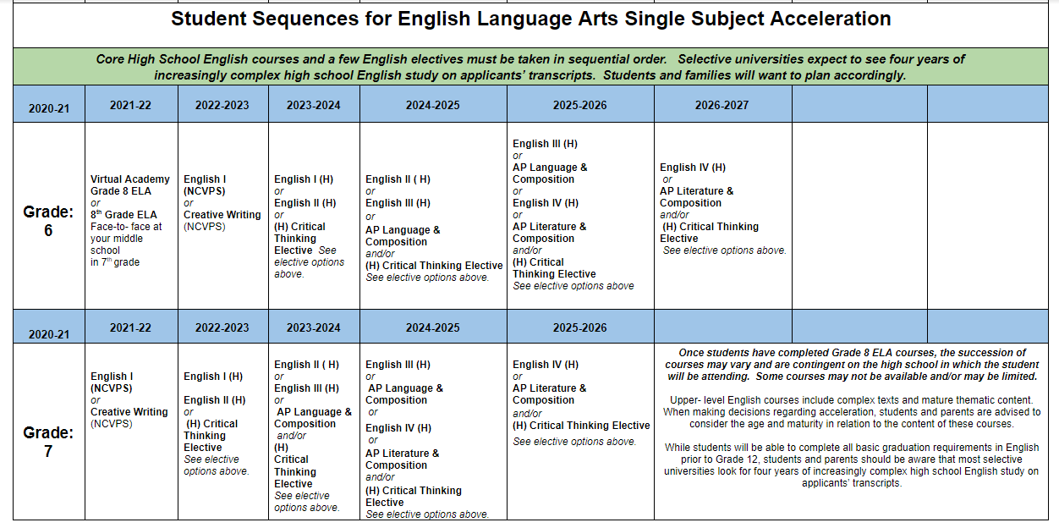
SSA ELA
SSA ELA Trajectory
21-22
22-23
23-24
24-25
25-26
26-27
27-28
21-22
22-23
23-24
24-25
25-26
26-27
27-28
Notes:
First red circle: Current 6th graders who qualify to skip 7th grade ELA will enroll in the Grade 8 course face to face in their middle school during their 7th grade year. During the students 7th grade year, they will enroll in EITHER English I (NCVPS) or Creative Writing (NCVPS) for a year-long course. Students must only choose one of these two courses.
Click to second red circle: Current 7th graders who qualify to skip 8th grade ELA will enroll in EITHER English I (NCVPS) or Creative Writing (NCVPS) for a year-long course during their 8th grade year. Students must choose one of these two courses only.
Click to blue circle: Once students have completed Grade 8 ELA courses, the succession of courses may vary and are contingent on the high school in which the student will be attending. Some courses may not be available and/or may be limited.
Upper- level English courses include complex texts and mature thematic content. When making decisions regarding acceleration, students and parents are advised to consider the age and maturity in relation to the content of these courses.
While students will be able to complete all basic graduation requirements in English prior to Grade 12, students and parents should be aware that most selective universities look for four years of increasingly complex high school English study on applicants’ transcripts.

Slide 12
SSA Math Assessments
Student Current Grade Level | Grade/ Course Requesting to Skip | Assessment used to Qualify | Assessment Format | Qualifying Criteria
Kindergarten | 1st Grade Math | 1st Grade NCDPI Summative Math Assessment | Individual constructed response tasks, created by NCDPI | Student receives a 3 (proficient) on each assessment task (will be reviewed by centralized team)
1st Grade | 2nd Grade Math | Grade 2 Assessment | Multiple choice and gridded response items with both calculator active and inactive sections. | >80% correct on Acceleration Assessment
2nd Grade | 3rd Grade Math | Grade 3 Assessment
3rd Grade | 4th Grade Math | Grade 4 Assessment
4th Grade | 5th Grade Math | Grade 5 Assessment
5th Grade | 6 PLUS Math | 6 PLUS Assessment
6th Grade and 7th Grade | 7 PLUS Math | 7 PLUS Assessment
Notes:
This slide outlines the assessment format and qualifying criteria for students looking to skip math content.
Students who are currently in Kindergarten, will need to be proficient or score a level 3 on each performance task on the end of year 1st grade assessment.
In order for students who are currently in grades 1- 7 to qualify for SSA in math, they will need to score an 80% or higher on the acceleration assessment.
There are multiple choice and gridded response items on the assessments given to these grade levels. Current 7th grade students taking the math 7 course CAN take the 7+ SSA test to be placed in NC1 next year.

Slide 13
SSA Math Trajectory
2021-22 Math Course | 2022-23 | 2023-24 | 2024-25 | 2025-26
4th Grade (passes 5th grade math SSA tests) | 6 Plus face to face Or online | 7 Plus | NC Math 1 (for high school credit) | NC Math 2 (for high school credit) | NC Math 3 Honors (for high school credit)
5th Grade (passes the 6+ math test) | 7 Plus face to face | NC Math 1 (for high school credit) | NC Math 2 Honors (for high school credit) | NC Math 3 Honors (for high school credit)
Math 6 (passes 7+ math test) | NC Math 1 (for high school credit) | NC Math 2 (for high school credit) | NC Math 3 Honors (for high school credit)
6 Plus (passes 7+ math test) | NC Math 1 (for high school credit) | NC Math 2 Honors (for high school credit) | NC Math 3 Honors (for high school credit)
Math 7 (passes 7+ math test) | NC Math 1 (for high school credit) | NC Math 2 Honors (for high school credit)
Notes:
If you do wish to skip math content, then math SSA will allow a student to do so. In first grade through 4th grade schools create schedule for students to obtain instruction within the school building. When a student is in 5th grade they will be taking math 6+. Most elementary schools offer math 6+ online, but some may offer a face to face course.
This chart outlines the math trajectory if a student takes and qualifies for SSA math in grades 4-7. It’s important to keep in mind the math electives or options at the high school level when deciding is SSA is the best fit for your child.

Slide 14
Waiver Process
Different placement:
Parents can request a higher or lower placement
Process:
Complete the waiver form and return it to your current school principal.
The principal reviews all waiver requests.
For additional information please read the Math Placement Guidelines
Please direct additional questions about math placement to the school counselor.
**Waivers cannot be submitted to SKIP courses. In order to SKIP courses, students must go through the Single Subject Acceleration (SSA) process.**
Notes:
Parents and Guardians may request a higher or lower math placement by completing a waiver form. As a reminder, waivers cannot be submitted to SKIP courses. In order to SKIP courses, students must go through the Single Subject Acceleration (SSA) process. Parent waivers can be found on the WCPSS website.

Slide 15
SSA Data of Students Tested in Math
Qualifies for SSA
Notes:
SSA testing is rigorous. One in five students tested qualify for math Single Subject Acceleration.
The number of students to qualify for Single Subject Acceleration in ELA is less.

Slide 16
SSA Results
SSA contact will communicate results
SSA services will not take place until the next school year
Notes:
The SSA contact at your school will communicate SSA results with parents once scores have been received.
SSA services will not take place until the next school year begins

Slide 17
Is my child a good candidate for SSA?
Consider your child’s social and emotional maturity.
Your child may be taking classes with peers who may be older.
Consider your child’s organizational skills and ability to focus.
Can your child begin or complete projects by themselves?
Notes:
Consider your child’s social and emotional maturity, organizational skills, and ability to focus as students An SSA student will be taking classes with peers who may be older or they will be working on their own.

Slide 18
Is my child a good candidate for SSA?
Your child will be skipping an entire year’s worth of content and background knowledge.
The AIG teacher and homeroom teachers are not responsible for covering any content your child skipped as a result of receiving SSA services.
If your child qualifies for SSA in math or ELA in elementary or middle school, some courses take place online. During the school day, students participate independently in these online courses.
SSA may result in a different class schedule. To accommodate your child's academic needs, the school may assign your child a nontraditional schedule. The final decision about scheduling will be made by the principal at each school.
Notes:
Your child will be skipping an entire year’s worth of content and background knowledge. The AIG teacher and homeroom teachers are not responsible for covering any content your child skipped as a result of receiving SSA services.
If your child qualifies for SSA in math or ELA in elementary or middle school, some courses take place online. During the school day, students participate in these courses. Students work independently during their online lessons.
SSA may result in a different class schedule. To accommodate your child's academic needs, the school may assign your child a nontraditional schedule. The final decision about scheduling will be made by the principal at each school.

Slide 19
Parent Reflection
Have I had conversations about the need for skipping a whole grade level content with my child’s teacher?
How is my child currently performing in the subject area where I might request acceleration?
Have I considered what SSA might look like and mean for my child in future grades?
Do all conversations and data indicate that my child has a need for skipping a year’s worth of content in order to receive access to rigorous curriculum or challenging curriculum?
Notes:
Determining if your child is a good candidate for SSA can be a challenging decision. Take time to reflect about these four questions.
Have I had conversations about the need for skipping a whole grade level content with my child’s teacher?
How is my child currently performing the subject area where I might request acceleration?
Have I considered what SSA might look like and mean for my child, in future grades?
Do all conversations and data indicate that my child has a need for skipping a year’s worth of content, in order to receive access to rigorous curriculum or challenging curriculum?

Slide 20
Summary
Single Subject Acceleration is for Wake County Public Schools students in Kindergarten through 7 grade.
A student is not allowed to skip Math 1
Complete the test request form by the end of the test request window assigned to your child’s school.
Students can test in one subject area only (reading or math)
Notes:
To recap
Single Subject Acceleration is for Wake County Public Schools students in Kindergarten through 7 grade.
A student is not allowed to skip Math 1 due to graduation sequence and requirements
Please make sure to complete the test request form by the end of the test request window assigned to your child’s school.
Students can test in one subject area only (reading or math)

Slide 21
Summary
The 2nd grade-7th grade math assessment has multiple choice and open ended question types
First grade has individual constructed response items
The ELA assessment has a written portion as well as multiple choice assessment.
Consider how Single Subject Acceleration will affect your child’s educational career for high school and college.
Notes:
The math assessment has multiple choice and open ended question types
The ELA assessment has a written portion well as reading.
Consider how Single Subject Acceleration will affect your child’s educational career for high school and college.

Slide 22
Notes:
. Thank you for your attention. If you have questions about this presentation, please reach to the Single Subject Acceleration contact at your school. Have a great day.

